Slide 1
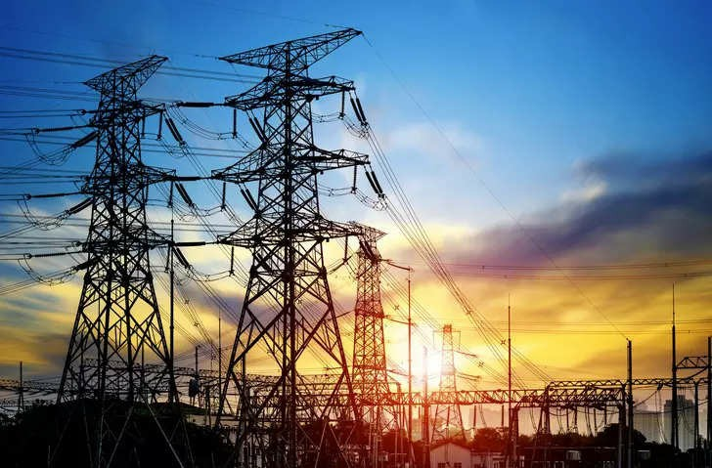
PLUGGING INTO THE FUTURE: An Exploration of Electricity Consumption patterns.

Slide 2

OVERVIEW
Power Consumption is the amount of
energy used per unit time.
Power Consumption of great
importance in digital systems.

Slide 3
PURPOSE
Electric energy consumption is the form of energy consumption that uses electrical energy.
Electric energy consumption is the actual energy demand made on existing electricity supply for transportation, residential, industrial, commercial and other miscellaneous purposes.

Slide 4
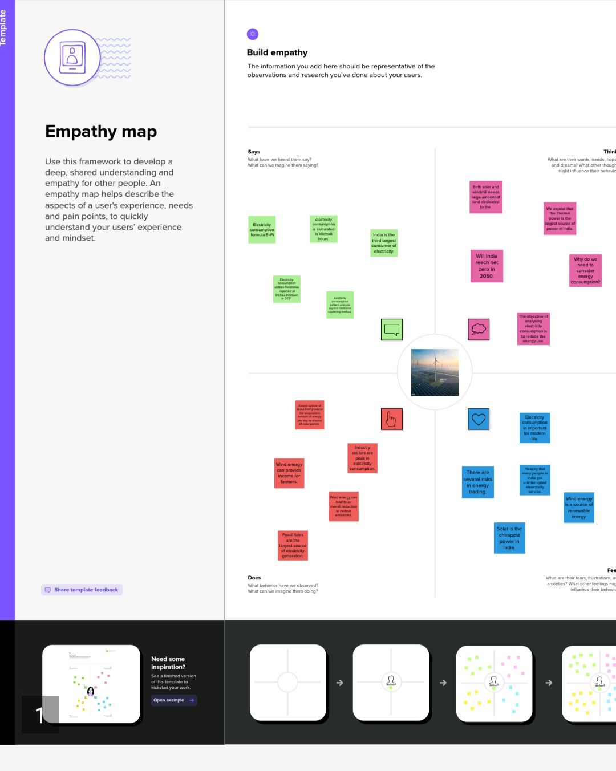
DESIGN THINKING

Slide 5
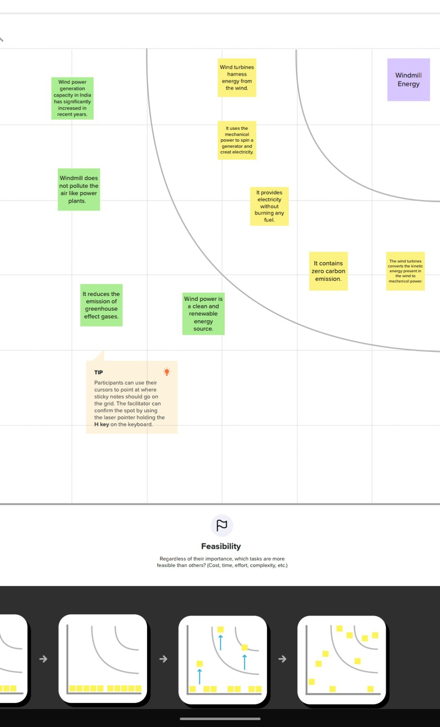
GRAPHICAL REPRESENTATION

Slide 6
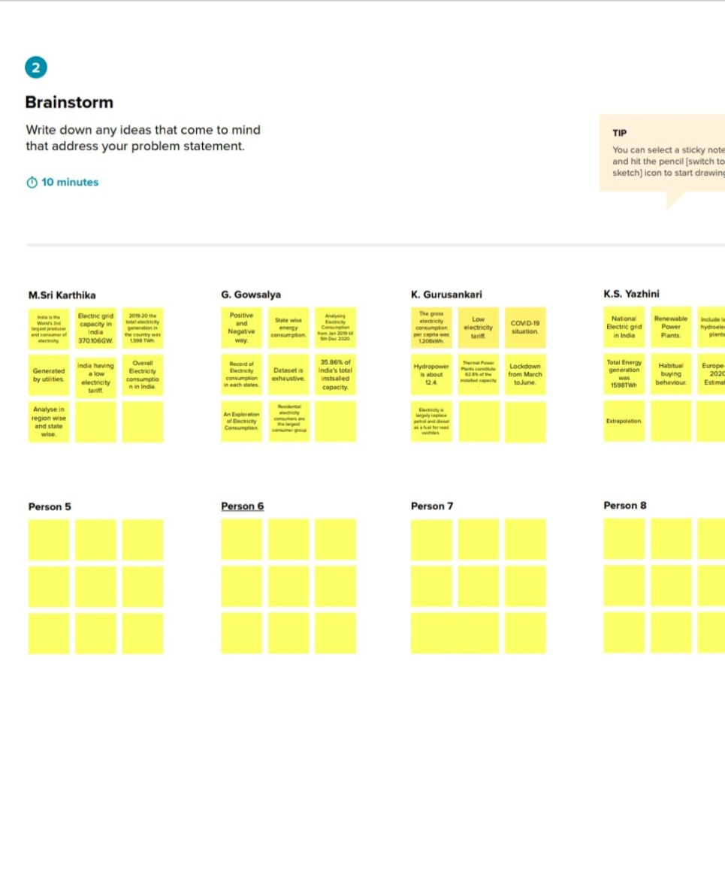
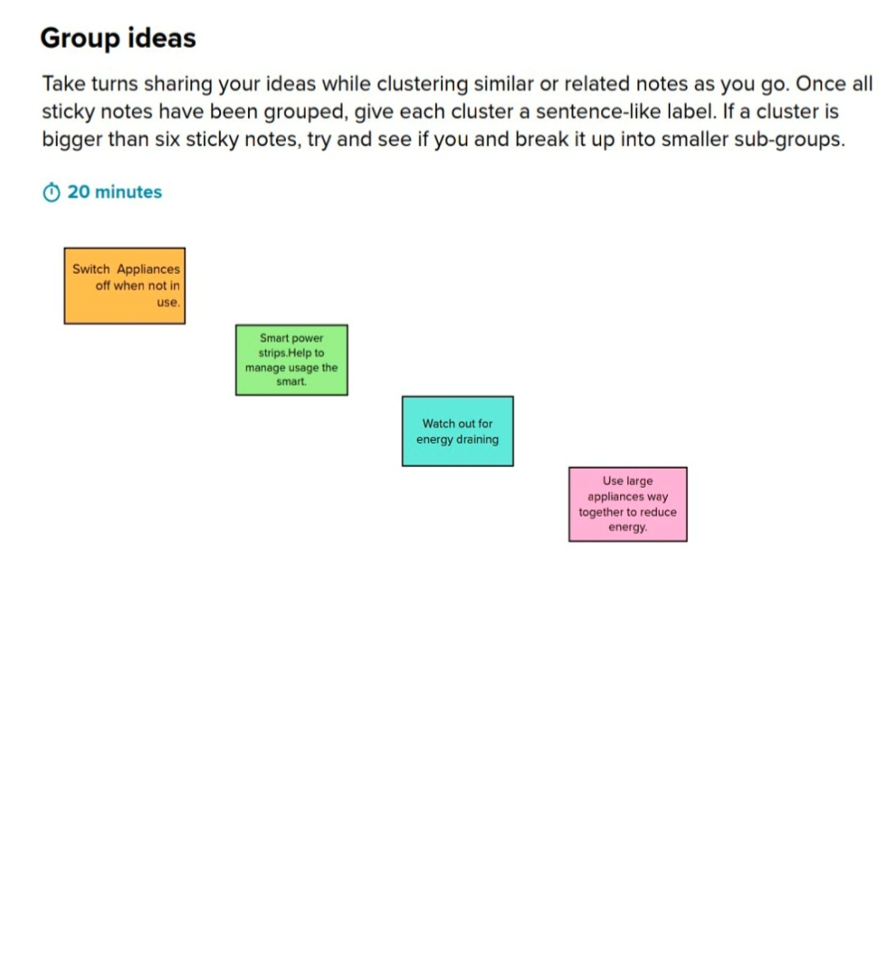
Brainstorming ideas

Slide 7
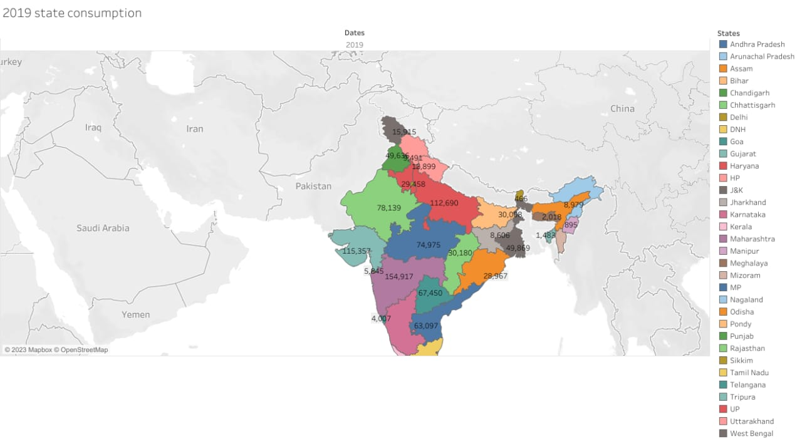
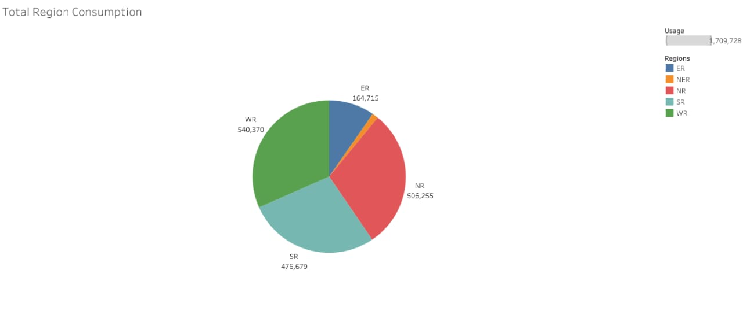
DASHBOARD

Slide 8
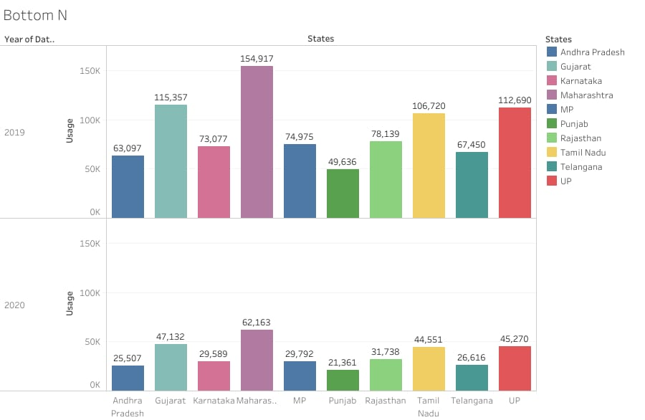

Slide 9
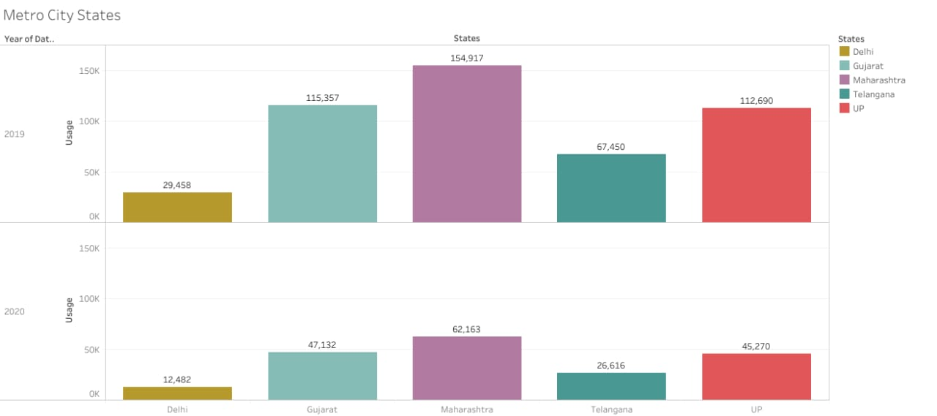

Slide 10
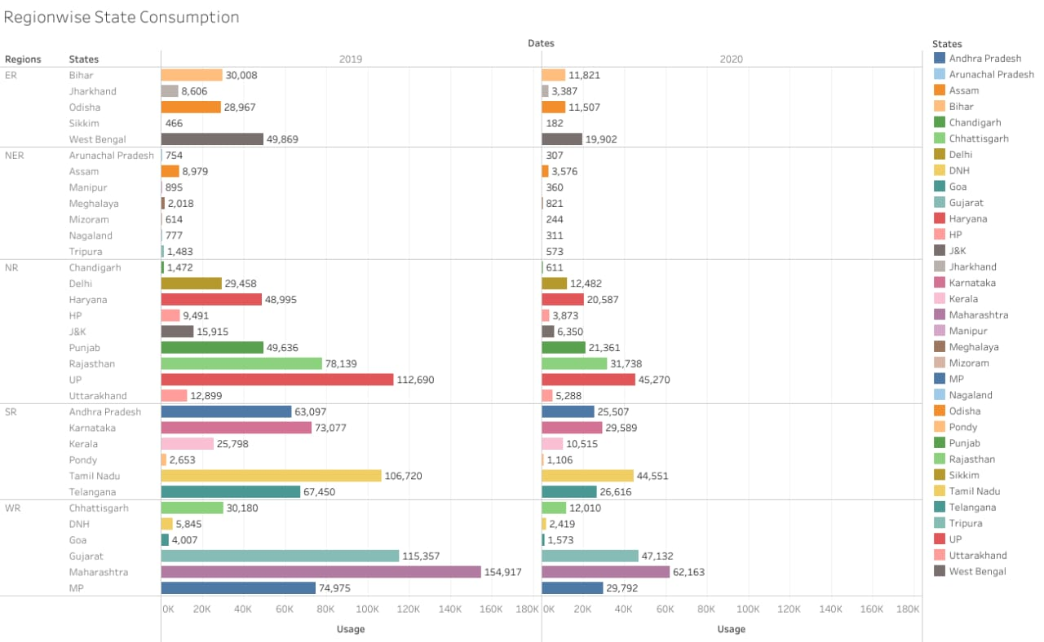
DASHBOARD 2

Slide 11
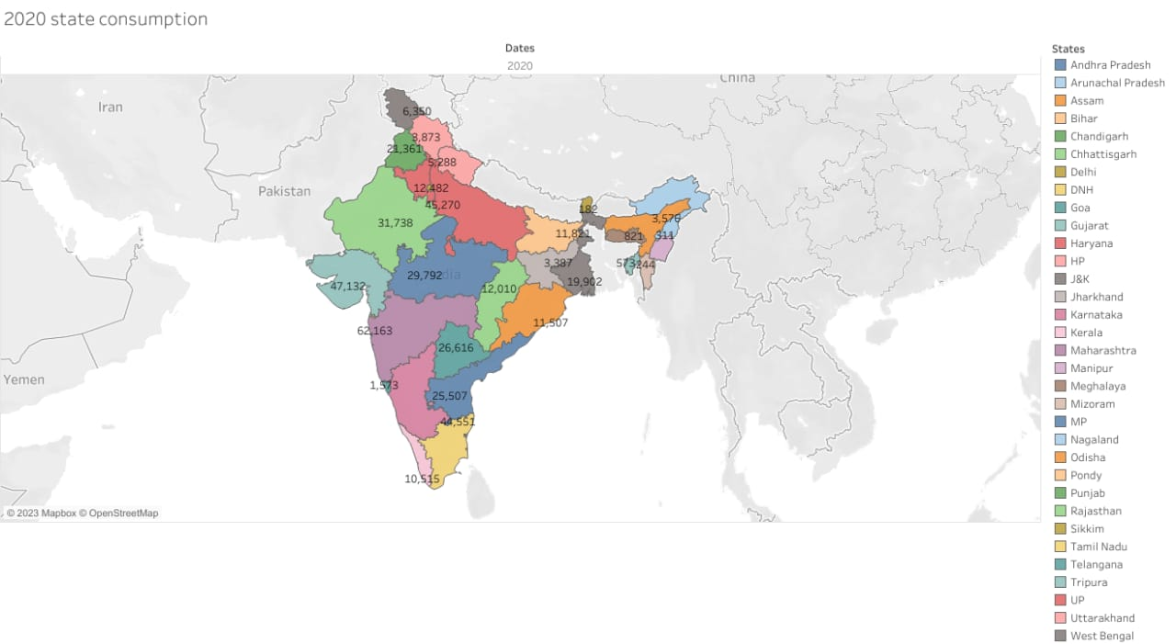

Slide 12
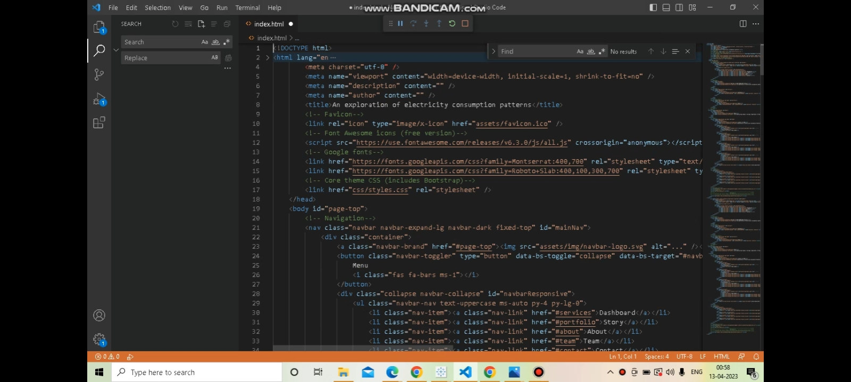
SOURCE CODE

Slide 13
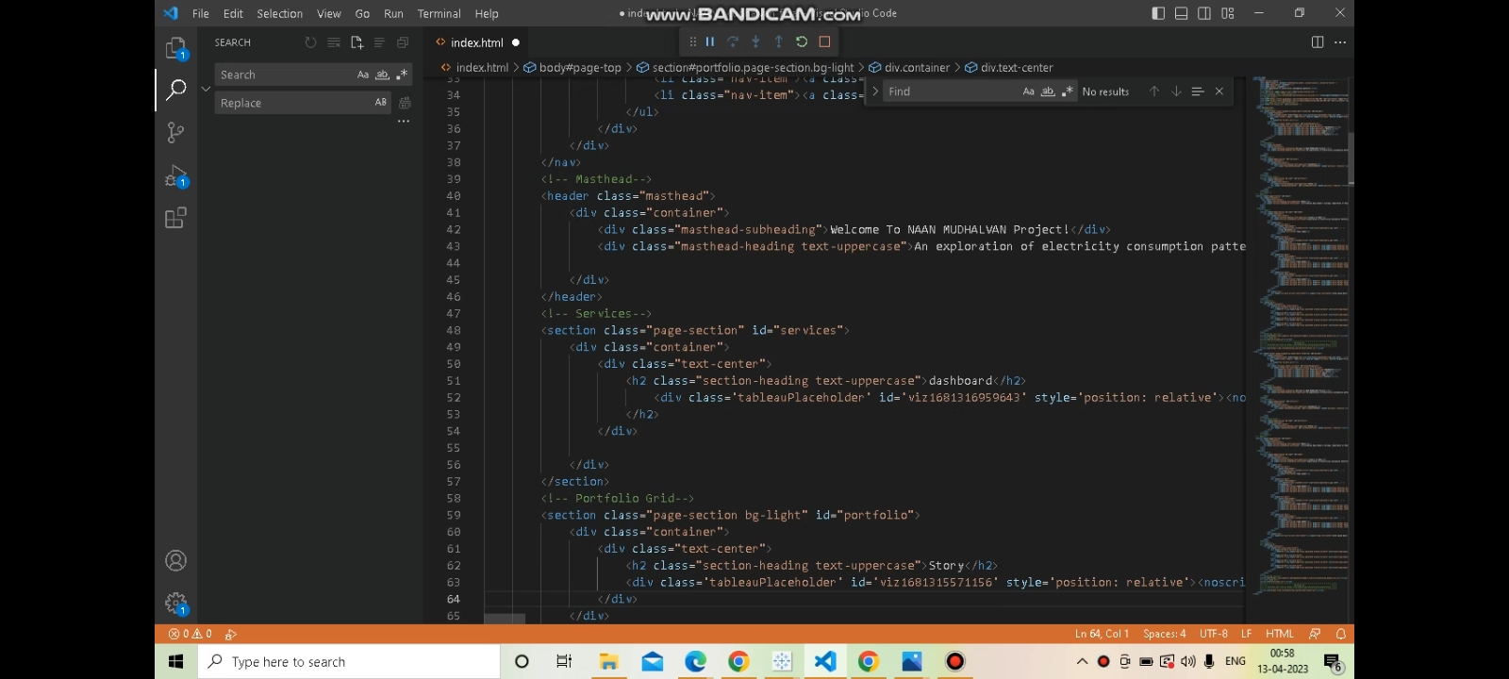

Slide 14
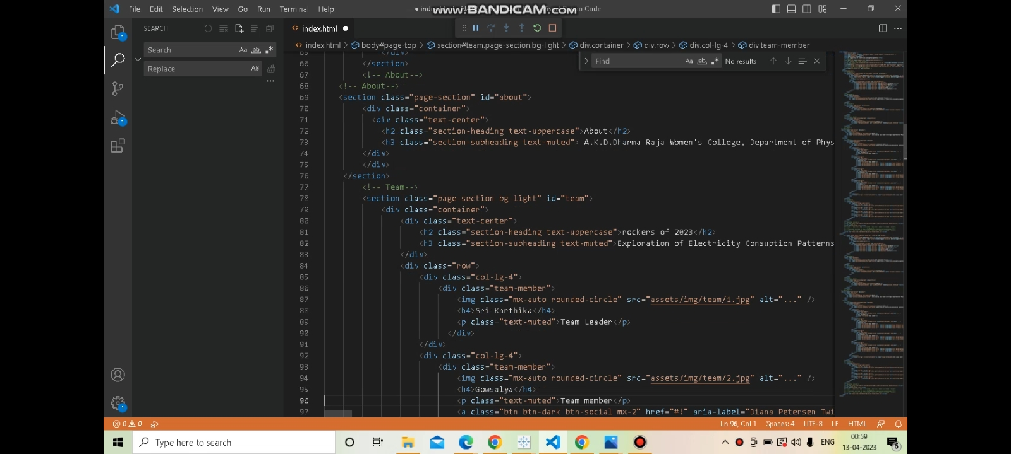

Slide 15
PROBLEM
ENERGY CONSUMPTION PROBLEM:
Poor electrical wiring in the house.
Faulty appliances.
Damaged power lines.
Lighting strikes.

Slide 16
SUMMARY
Electric energy consumption is energy consumption in the form of electrical energy.
About a fifth of global energy is consumed as electricity: for residential, industrial, commercial, transportation and other purposes.

Slide 17
TEAM LEADER: M. Sri karthika.
TEAM MEMBERS: G. Gowsalaya,
K. Gurusankari,
K.S.Yazhini.

